Slide 1

Applying Machine Learning Algorithms and SENTIMENt ANALYSIS FOR THE PREDICTION OF STOCK PRICES
Adriana Trigueros
September 2022

Slide 2
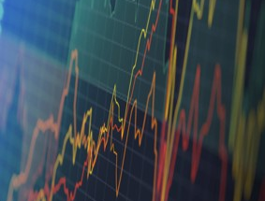
1. Main Overview

Slide 3
Research Background
The stock market serves as an important channel for companies to raise capital and investors with extra money looking to benefit from a company’s growth and distribution of earnings.
Furthermore, stock markets play a crucial role in promoting economic growth in a country by facilitating capital flow between investors and the users of money.
The mechanism in which the price of a stock is formed is highly complex (Jin et al., 2019). The ever-changing nature of stock prices is mainly due to the several variables that influence the price.

Slide 4

Research Questions
Is the sentiment of investors about a company in each day correlated to the closing price of the stock the next day?
Do machine learning algorithms (Random Forest, Linear Regression, and XGBoost) perform better than traditional models like ARIMA for predicting stock prices ?
Do deep learning algorithms (LSTM and Bidirectional LSTM) perform better than traditional models like ARIMA for predicting stock prices ?
What type of models, machine learning or deep learning, perform best for the prediction of stock prices?

Slide 5
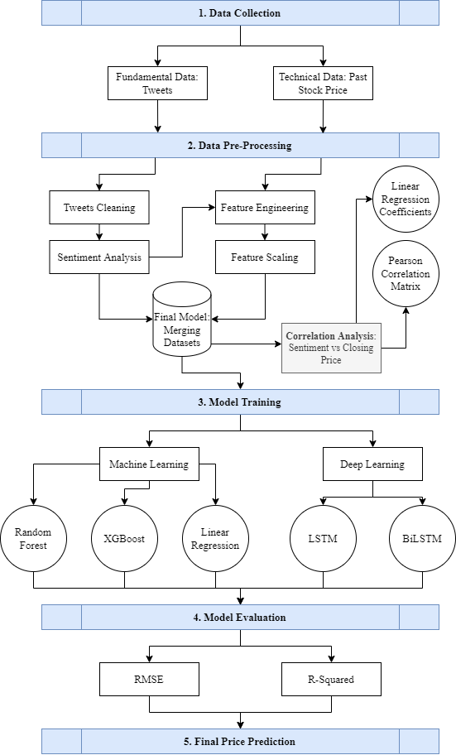
Proposed Scheme

Slide 6

2. METHODOLOGY

Slide 7



1. Data Collection
Twitter Data
Twint Scraping Tool
Stock Prices Data
Yahoo Finance

Slide 8
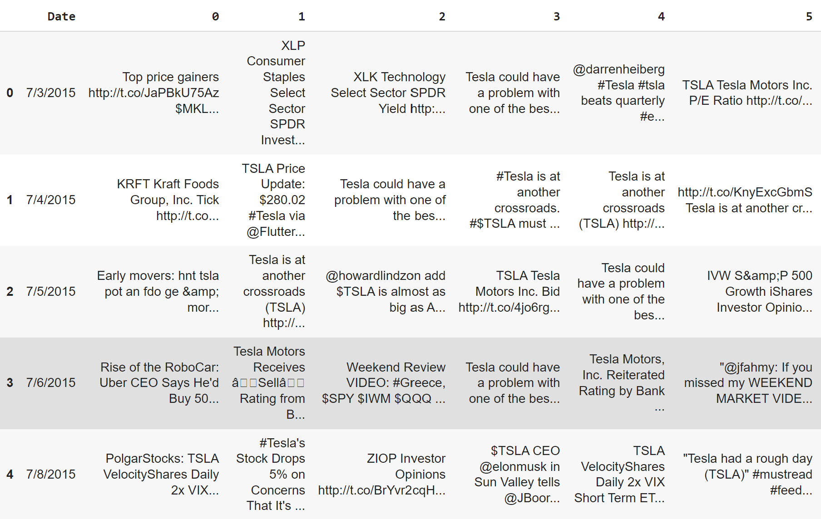
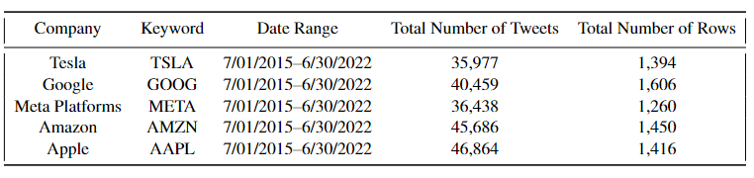
Twitter Dataset

Slide 9
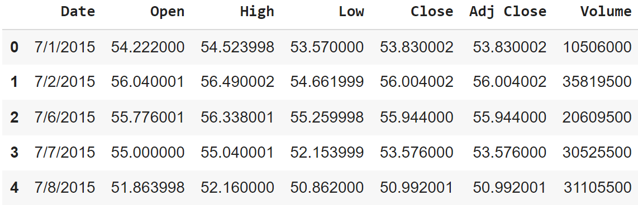
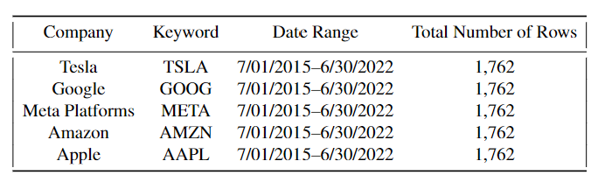
STOCK PRICES DATASET

Slide 10
1.1 Tweets Cleaning
Pulling data out of HTML and XML files – Beautiful Soup
Remove hashtags, @mentions, URLs, etc. – Regular Expressions
Remove non-alphabetic characters – Regular Expressions
Tokenization
Stop words removal
Lemmatization

Slide 11
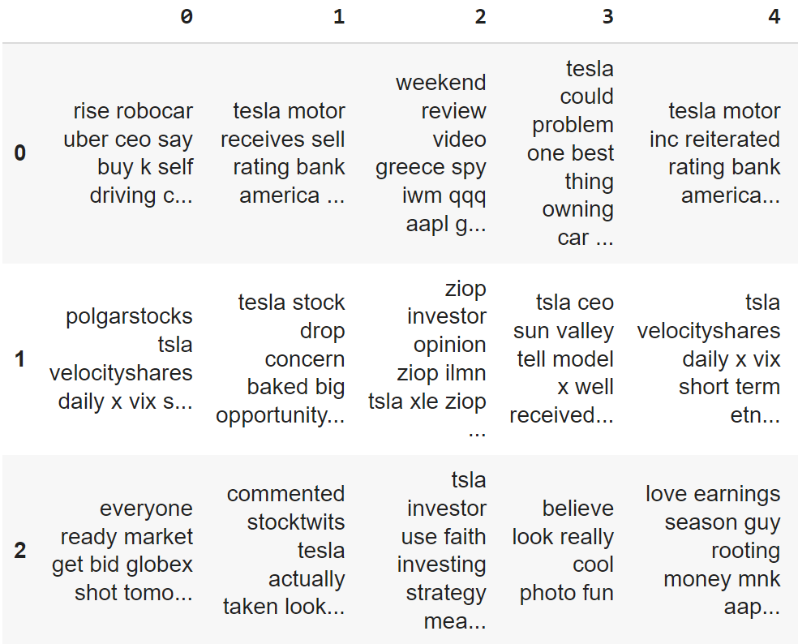
Twitter Dataset - Cleaned

Slide 12
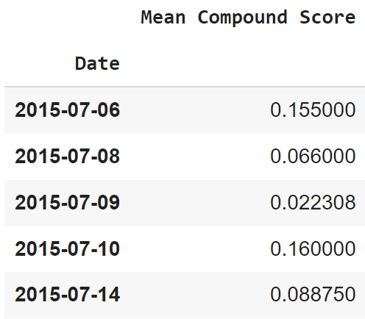
1.2 Sentiment Analysis
Rule based system
VADER

Slide 13
Sentiment Analysis Results

Slide 14
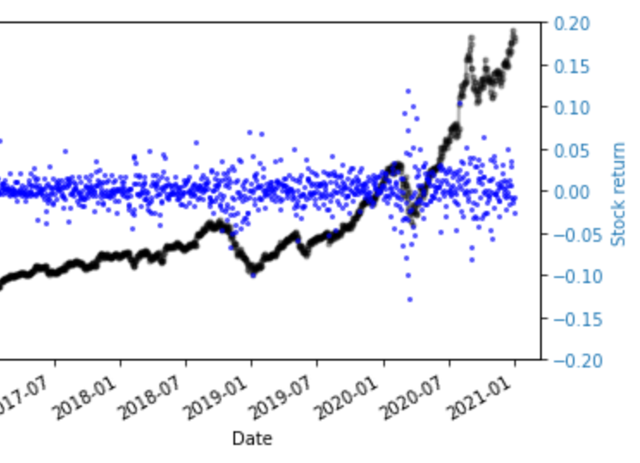
1.3 Feature Engineering
Calculating Stock Returns
Dropping Unnecessary Variables

Slide 15
1.2 Sentiment Analysis
Rule based system
VADER

Slide 16
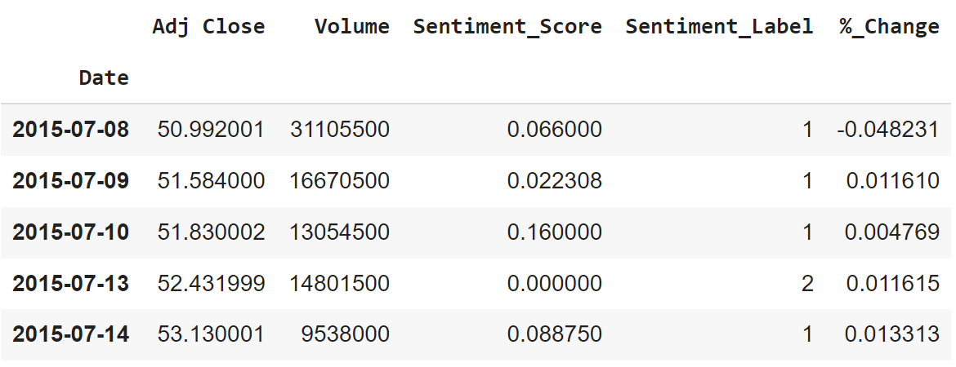
1.3 Merging Datasets 1.4 Rolling Windows 1.5 Train/Test Split 1.6 Feature Scaling
MODEL TRAINING

Slide 17

3. RESULTS

Slide 18

Key Findings: Proposed Models Performance

Slide 19
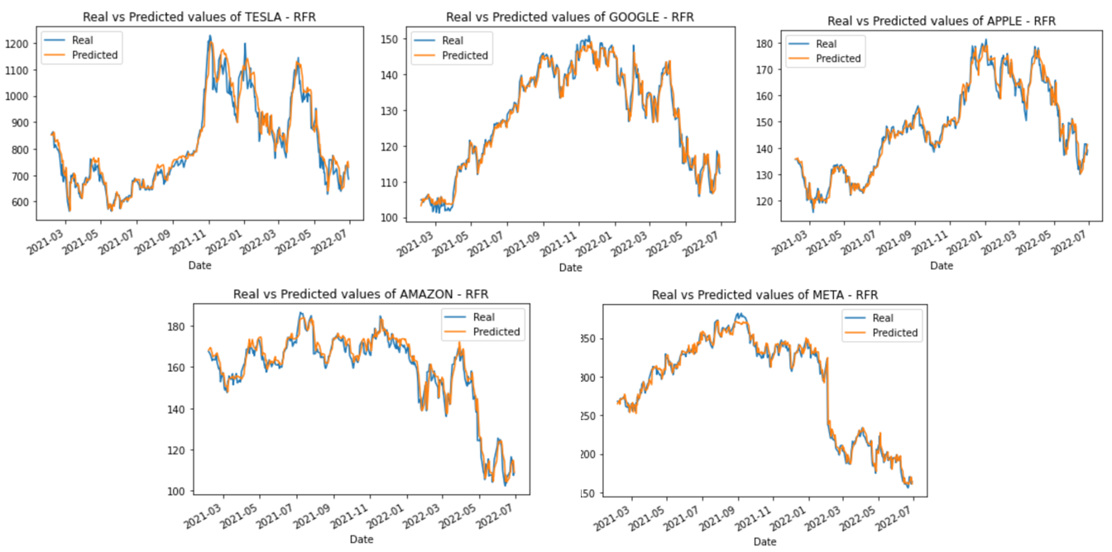
RANDOM FOREST REGRESSOR
Average R-Squared: 96.48%
Average RMSE: 0.0471

Slide 20
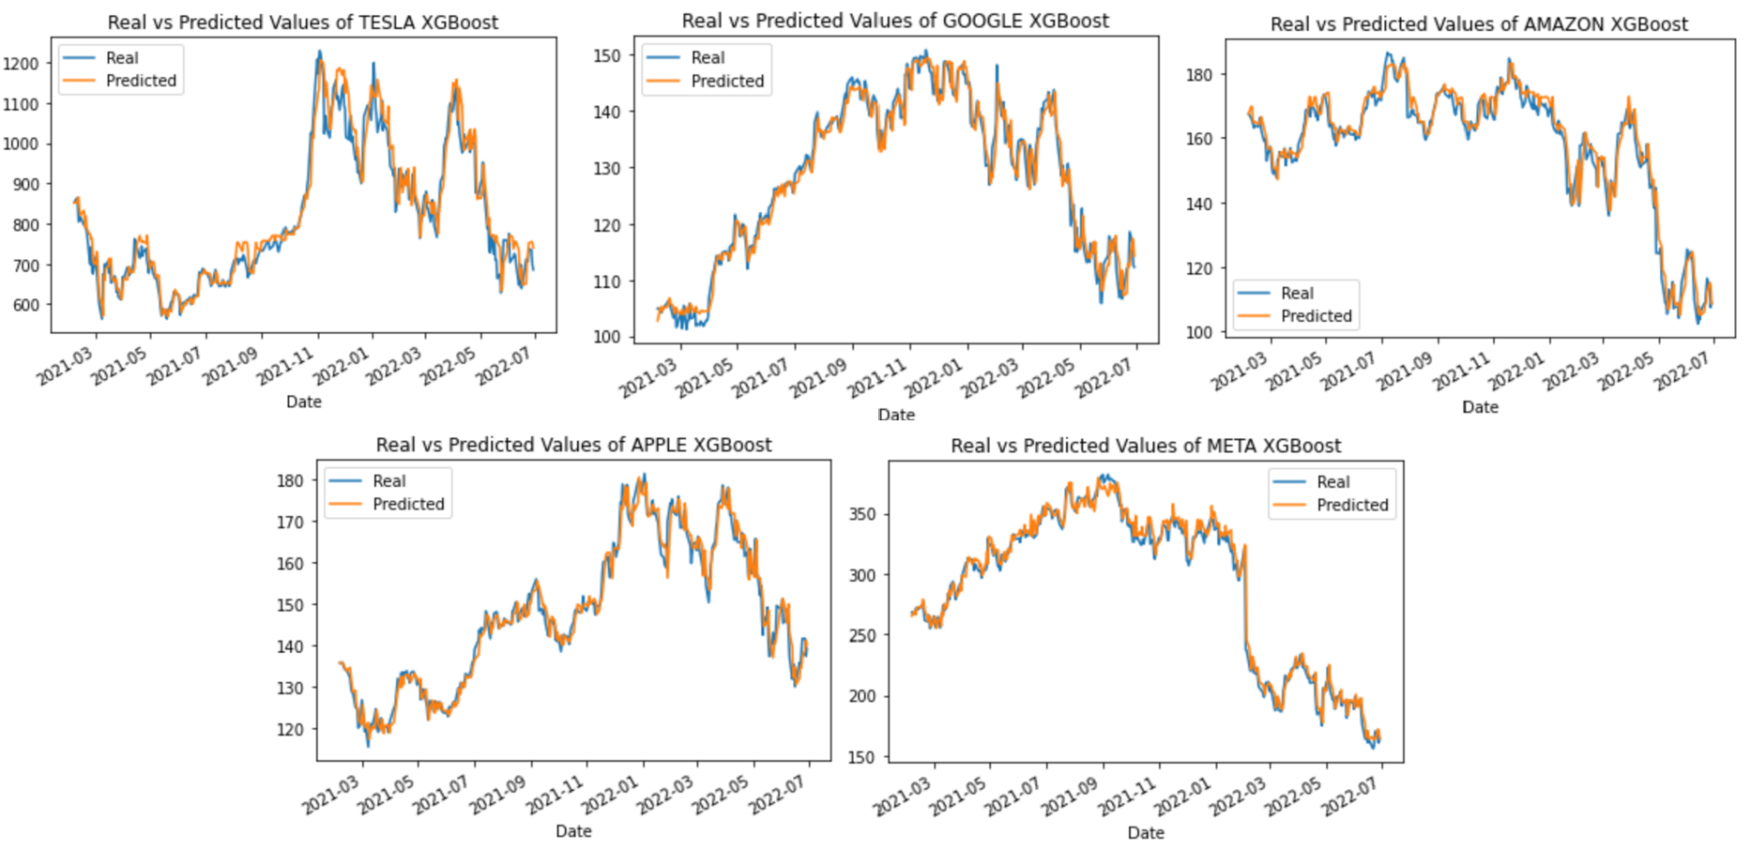
XGBOOST
Average R-Squared: 96.34%
Average RMSE: 0.0481

Slide 21
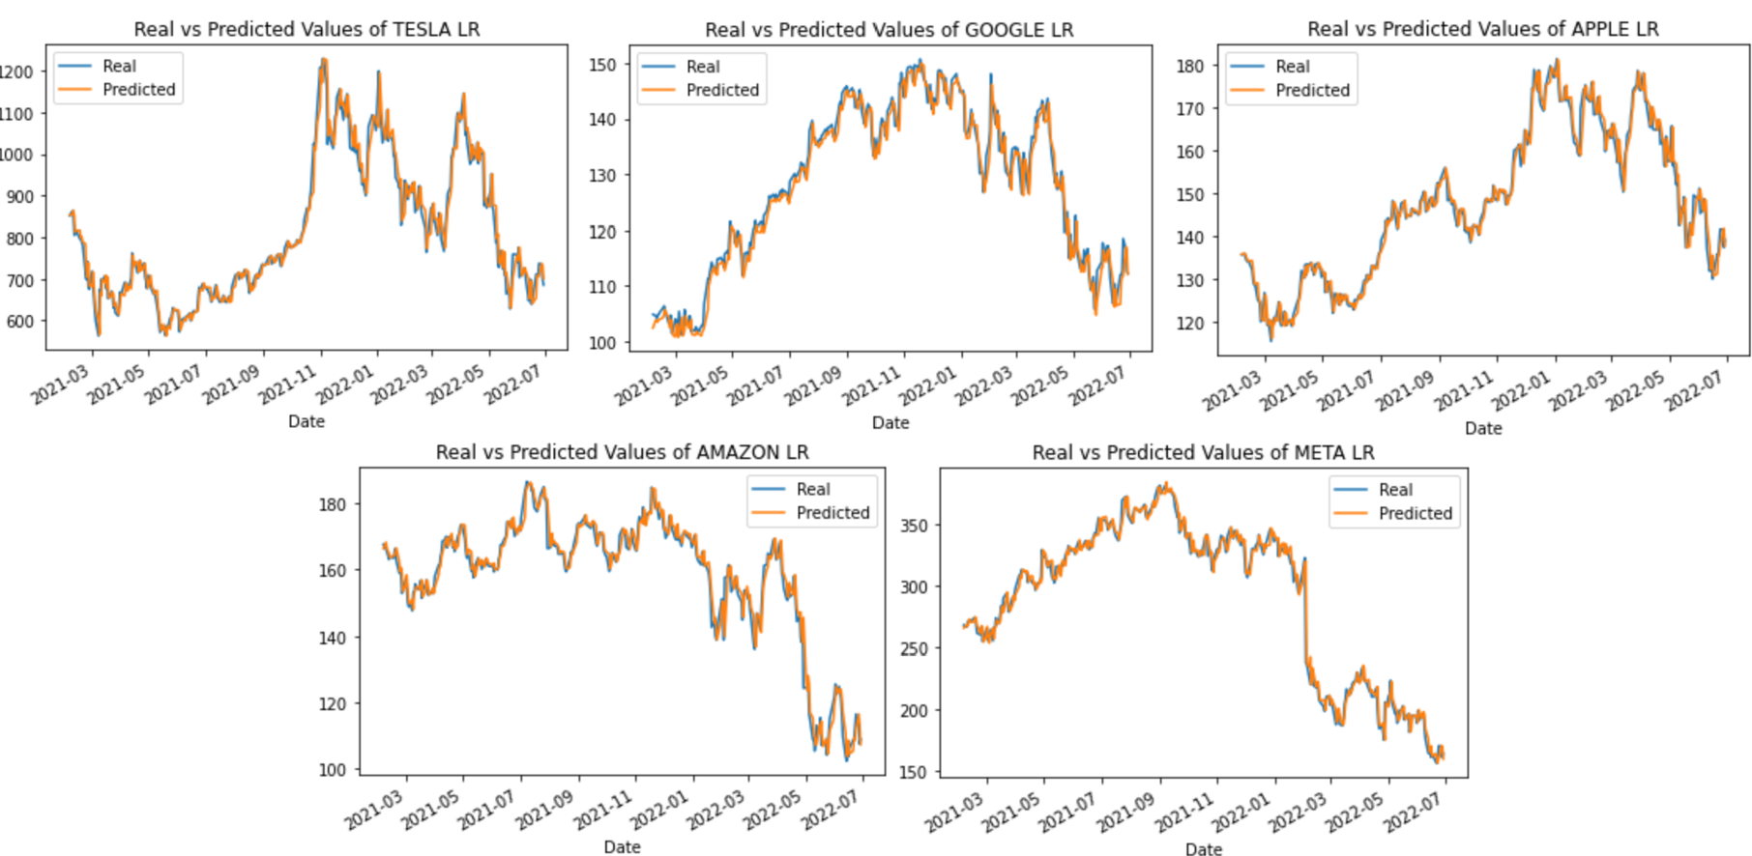
LINEAR REGRESSION
Average R-Squared: 97.16%
Average RMSE: 0.0431

Slide 22
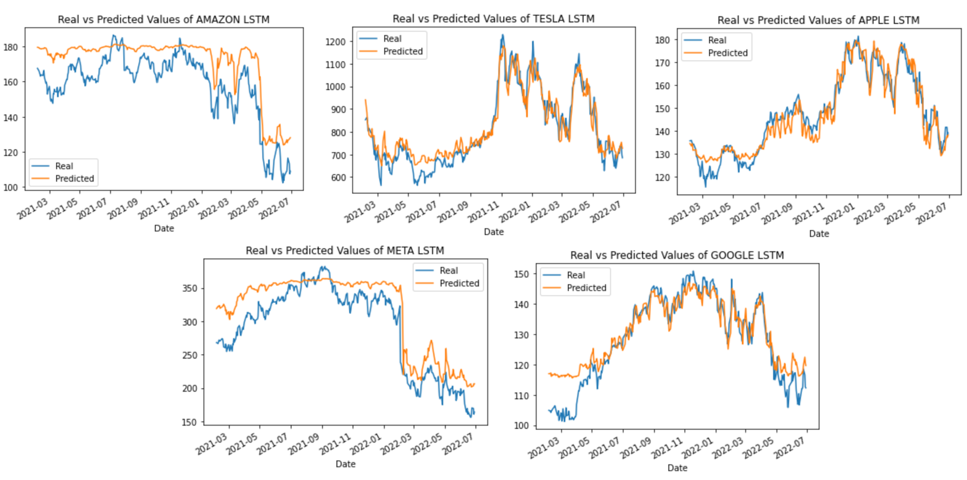
LSTM
Average R-Squared: 75.64%
Average RMSE: 0.1175

Slide 23
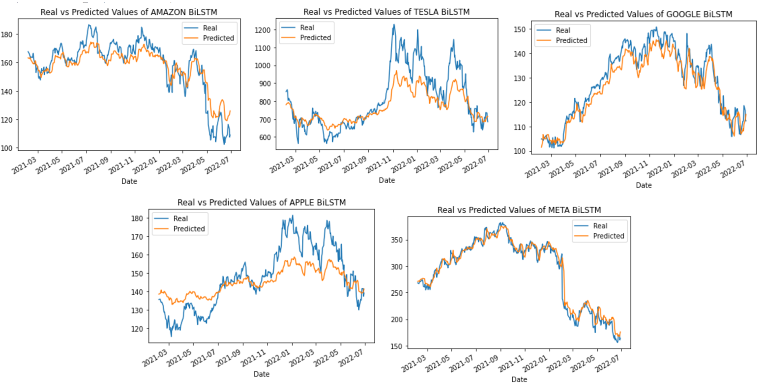
Bidirectional LSTM
Average R-Squared: 77.68%
Average RMSE: 0.1121

Slide 24
Key Findings: CORRELATION BETWEEN SENTIMENT AND CLOSING PRICE

Slide 25
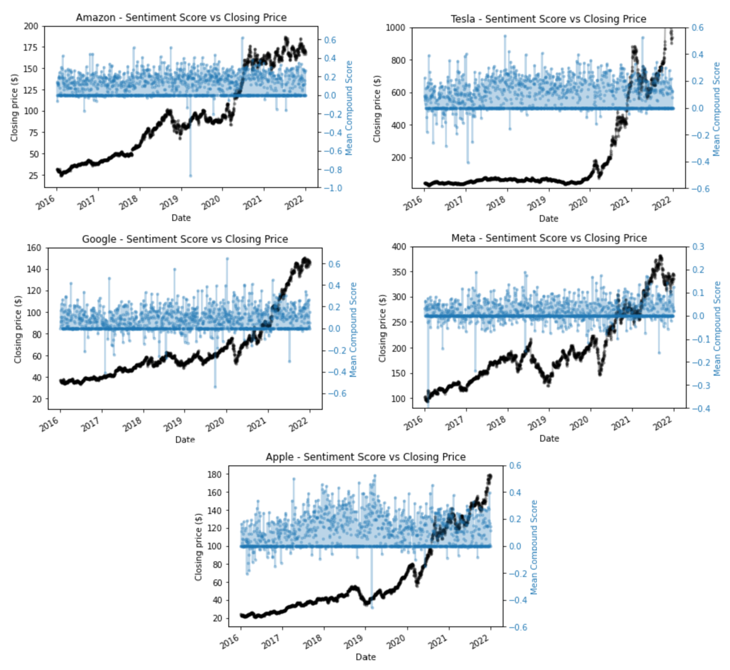
Plot: Sentiment vs Closing Price

Slide 26
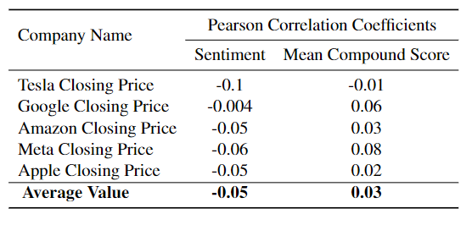
Pearson correlation matrix coefficients

Slide 27
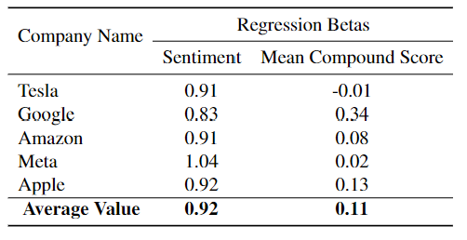
LINEAR REGRESSION coefficients

Slide 28
Conclusions
Some evidence was found indicating that the sentiment variable is correlated with the closing price of a stock, however, the results indicate a weak correlation and further studies need to be done.
The proposed models highly outperformed the baseline model ARIMA, the machine learning models performed best followed by deep learning models.
The use of the algorithms is limited for high-frequency traders to update their positions on a daily basis: go long if a positive change in price is predicted, otherwise go short.

Slide 29


